Slide 1
Bank Marketing
The data is related with direct marketing campaigns (phone calls) of a Portuguese banking institution.
The Analysis goal is to develop actionable insights and strategies for optimizing customer acquisition.

Slide 2
We have two datasets.
To merge them, I have addressed several issues.
Not the same names of columns and types of data.
Some columns are missing.
Different names for the same categories.
One dataset has month and day, other has only month and day of week.
What I did:
Identified and filled in missing year data.
Imputed the day of the week.
Converted categorical responses to binary values (1 and 0).
Standardized outcome categories.
Adjusted time values from seconds to minutes.
Merged similar categories into a single label.

Slide 3
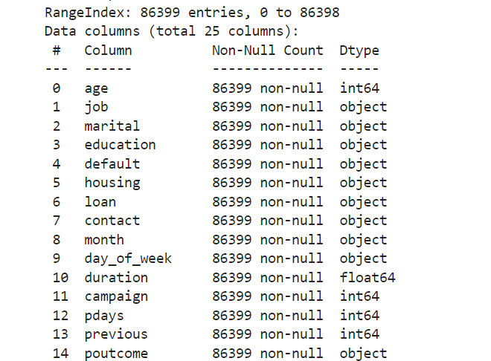
We have now one dataset.
86399 entries
25 columns

Slide 4
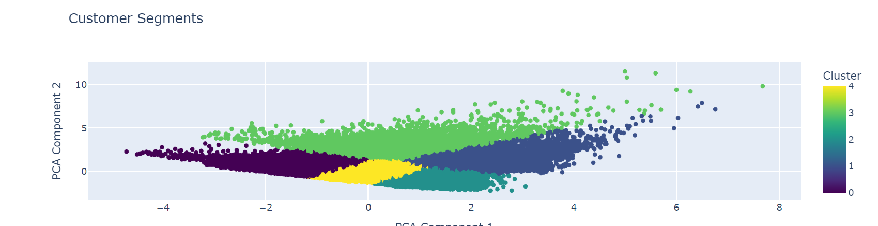
Customer segments
(job, marital status, education)

Slide 5
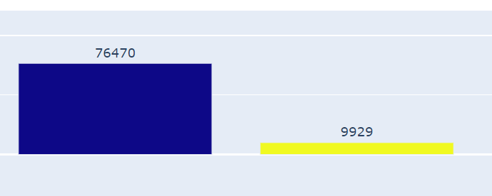
Our goal is make clients to say 'YES' to a term deposit, this tracked in the 'y' column, which I've converted to binary (1 for 'YES', 0 for 'NO').
no 76470
yes 9929

Slide 6
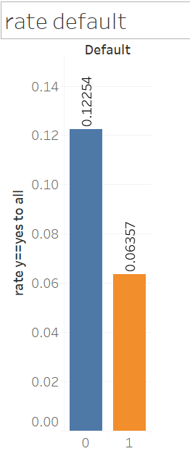
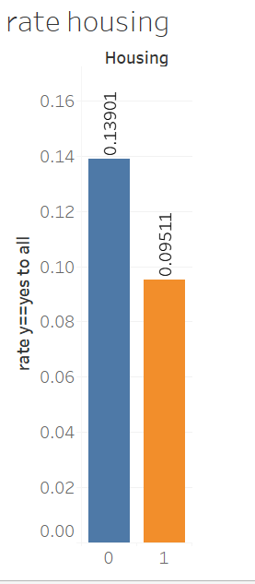
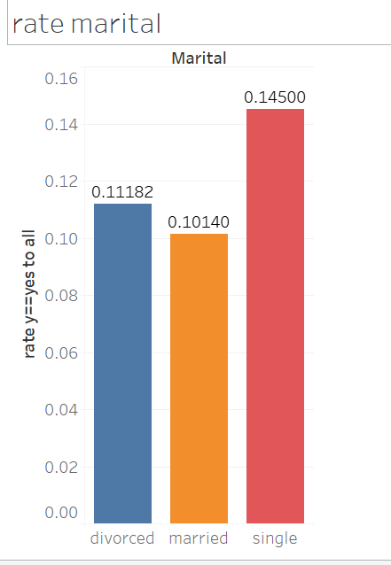

Slide 7
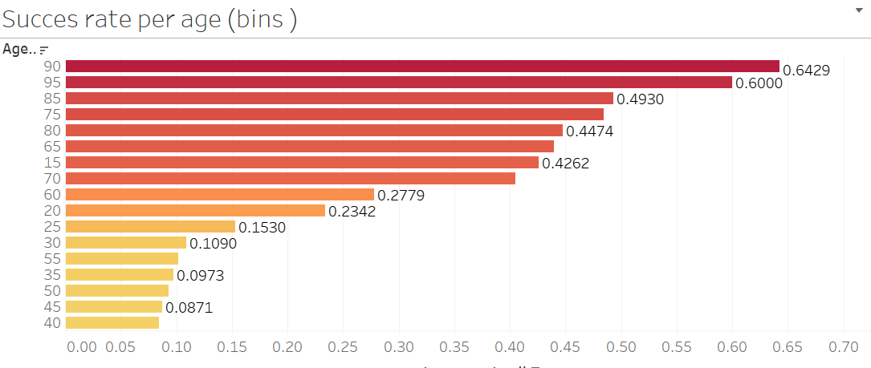

Slide 8
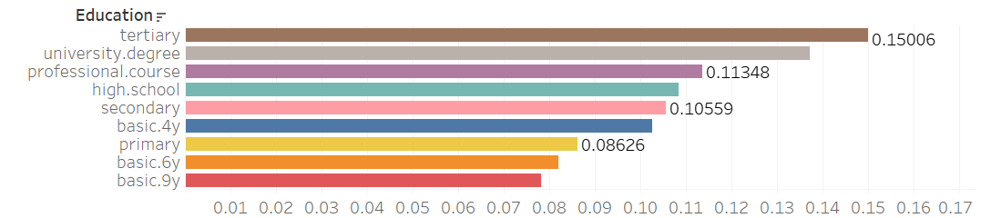
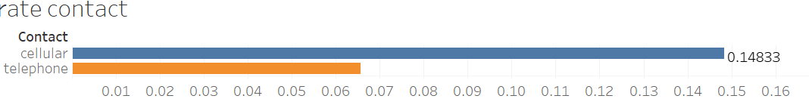

Slide 9
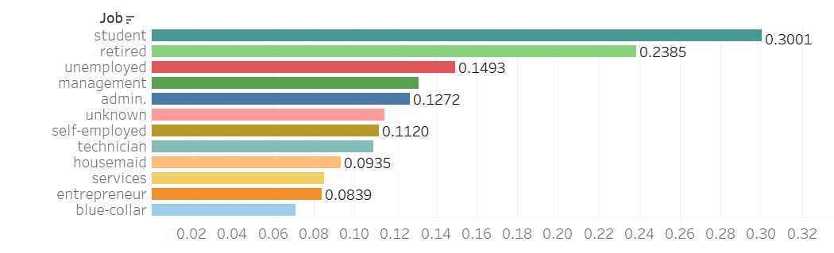

Slide 10
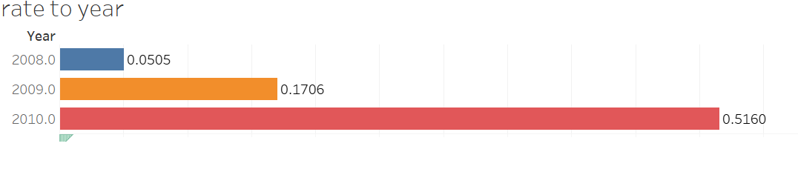
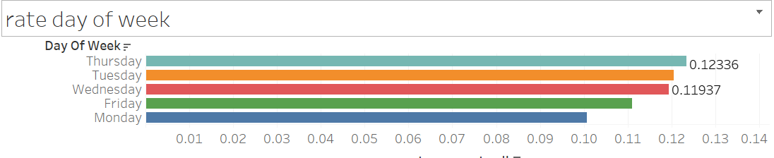

Slide 11
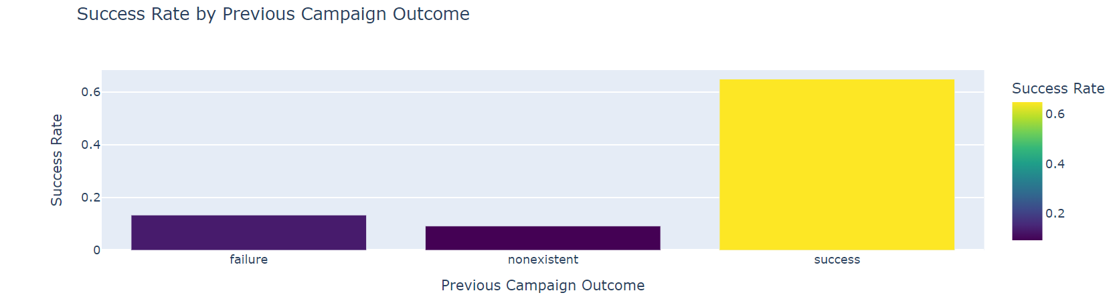

Slide 12
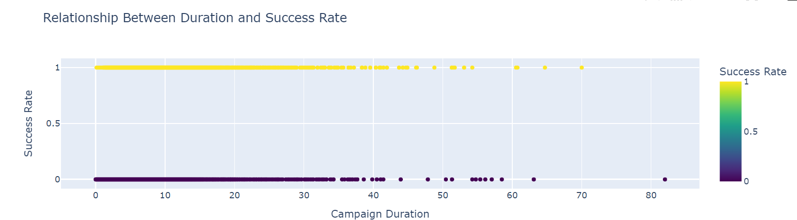
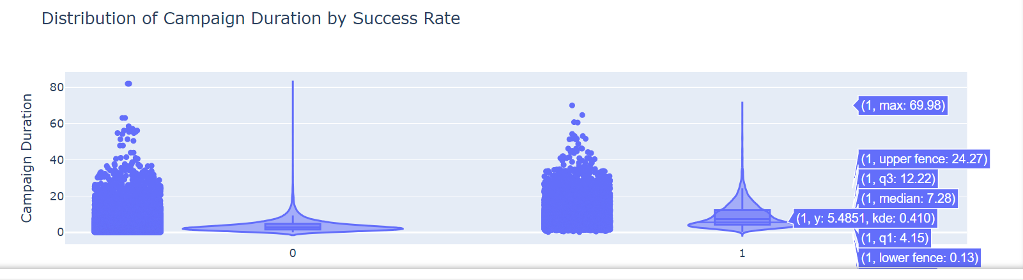

Slide 13
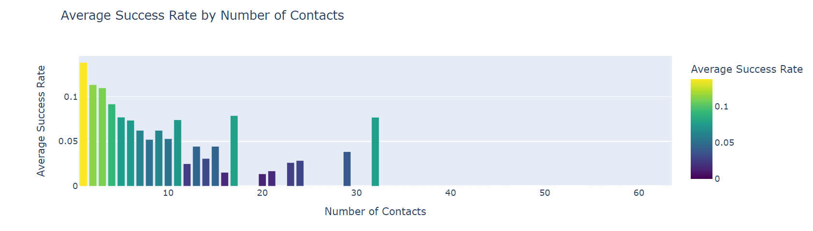

Slide 14
The most important insights
Previous Success Rate: Individuals who responded positively to previous campaigns are more likely to do so again, with a success rate of 60%.
Demographic Insights: Single people and those without other credits are more likely to respond positively.
Best and Worst Times: Mondays are the least effective for calls.
Age Factor: Older individuals are more likely to respond positively.
Education Level: More educated individuals are more likely to respond positively.
Call Duration and Quantity: The length and number of calls do not significantly impact the response; the longest call ended with a 'no.'
Preferred Contact Method: Cellular calls yield better results compared to other methods.
Campaign Improvement: Over the campaign’s three years, the success rate improved from 5% to 50%, indicating enhanced scripts or conditions.

